Slide 1
FOOD ORDERING SYSTEM

Slide 2
TABLE NAME: WAITER
FIELD | DATA TYPE | SIZE | CONSTRAINT
Waiter id | Int | 10 | Primary key
Waiter name | Varchar | 20 | Not null
Username | Varchar | 20 | Not null
password | Varchar | 20 | Not null

Slide 3
TABLE NAME: MENU’S
FIELD | DATA TYPE | SIZE | CONSTRAINT
Menu id | Int | 10 | Primary key
Food name | Varchar | 20 | Not null
Cost | Int | 10 | Not null
Food image | Int | 10 | Not null

Slide 4
TABLE NAME: ORDER
FIELD | DATA TYPE | SIZE | CONSTRAINT
Order id | Int | 10 | Primary key
Table id | Int | 10 | Foreign key
Menu id | Int | 10 | Foreign key
Quantity | Int | 5 | Not null
Order status | Varchar | 10 | Not null

Slide 5
TABLE NAME: BILLING
FIELD | DATA TYPE | SIZE | CONSTRAINT
Bill id | Int | 10 | Primary key
Order id | Int | 10 | Foreign key
Customer name | Varchar | 20 | Not null
Total amount | Int | 10 | Not null

Slide 6
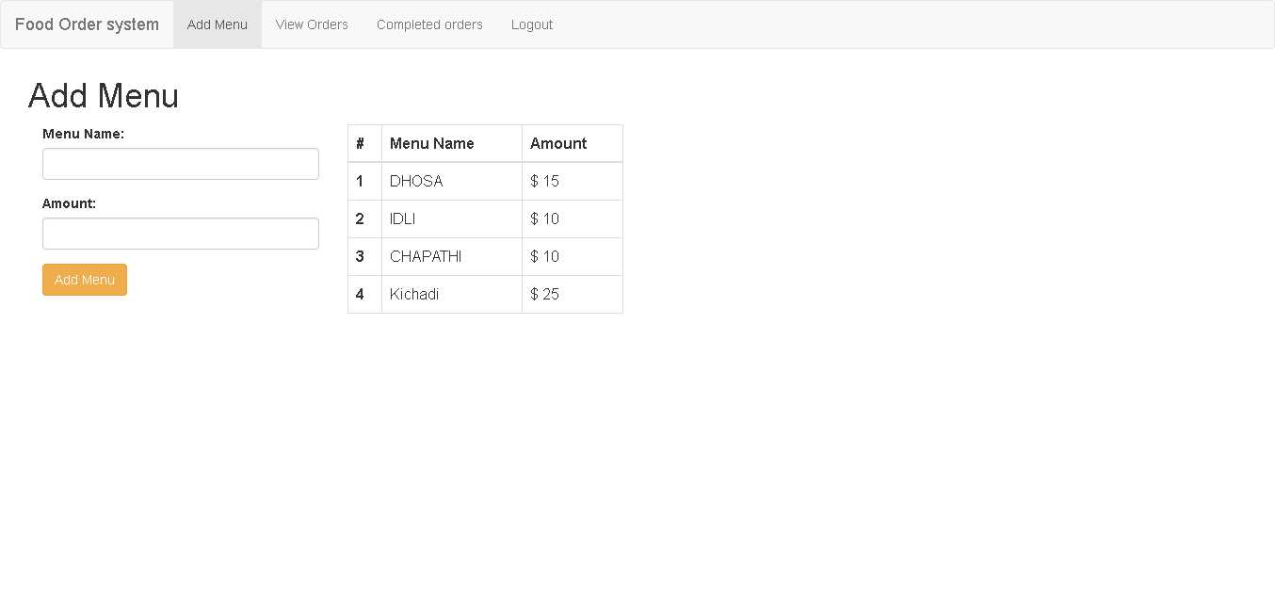

Slide 7
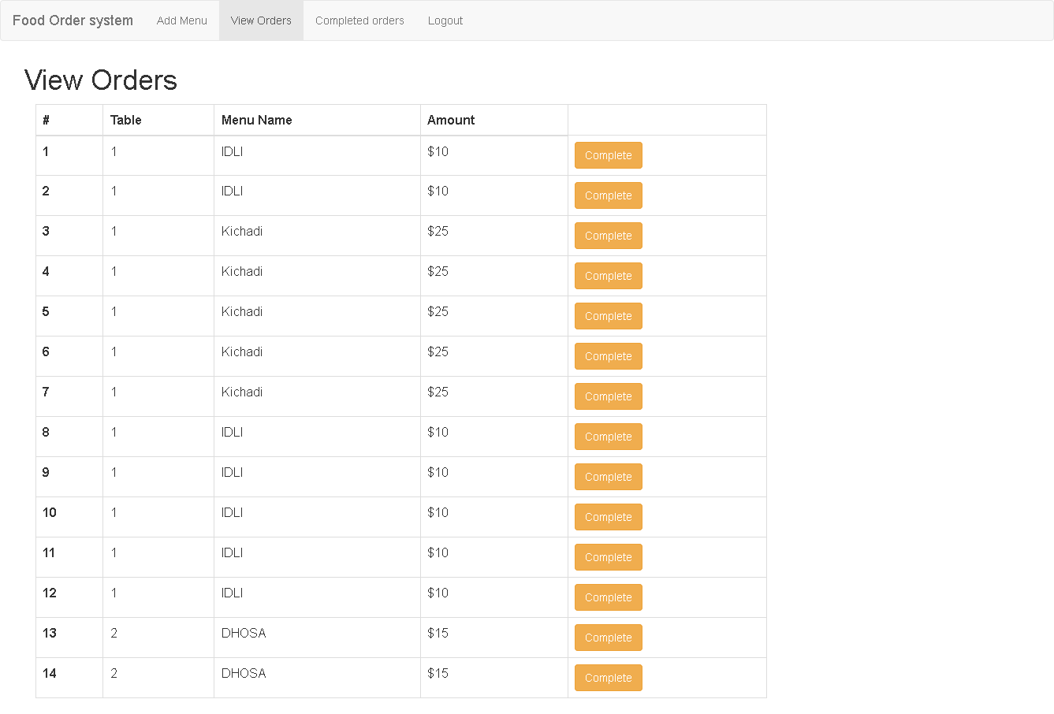

Slide 8
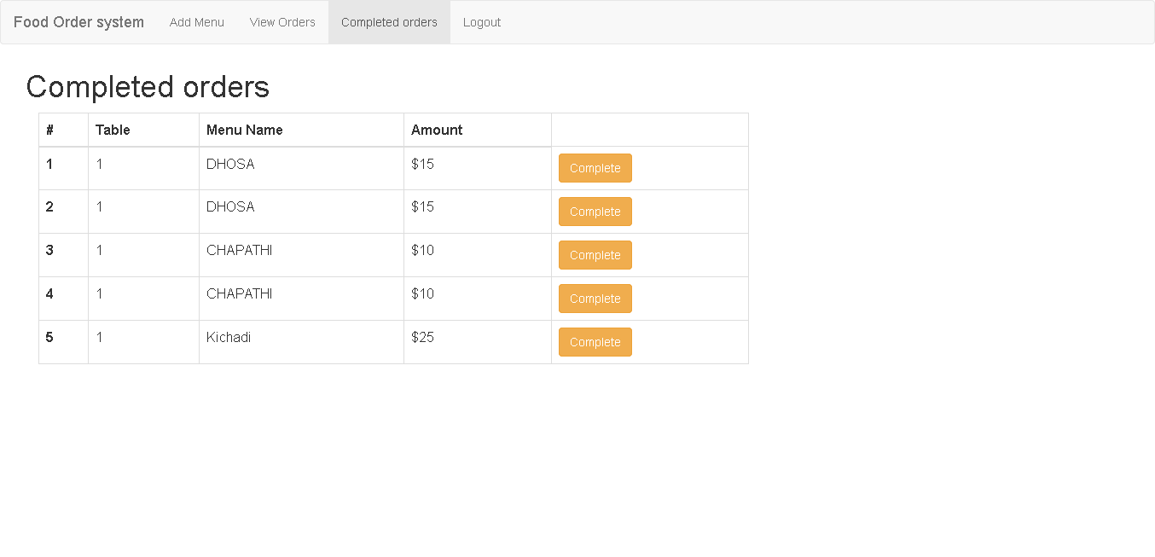

Slide 10
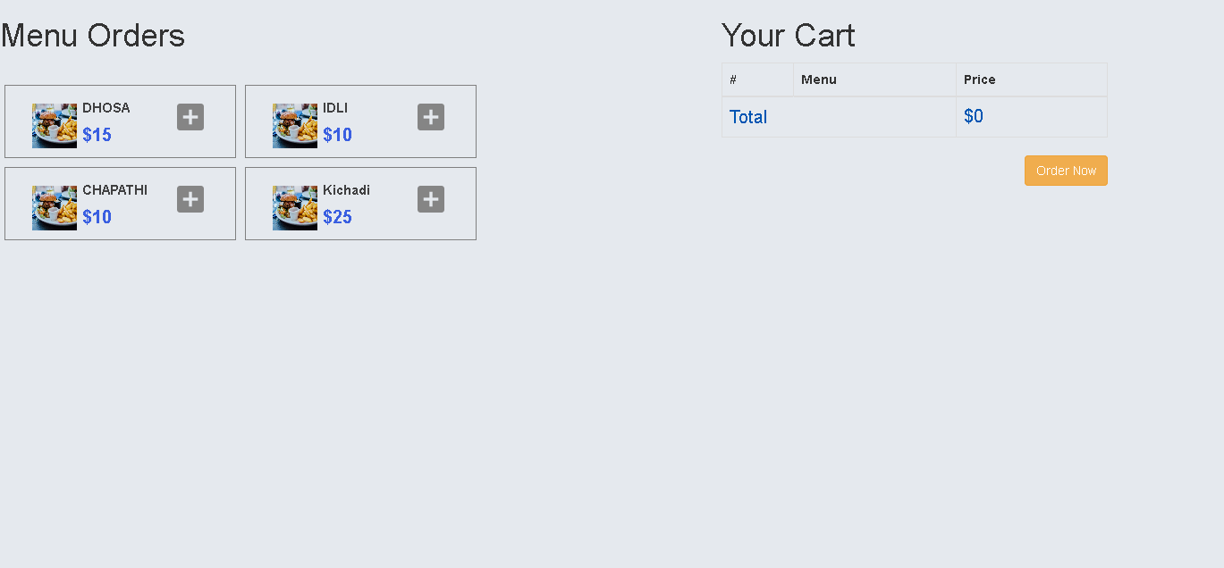

Slide 13
Thank You

